Slide 1
Welcome at MCC
Dr. Brigitte Knopf (MCC)
21 October 2018

Slide 2
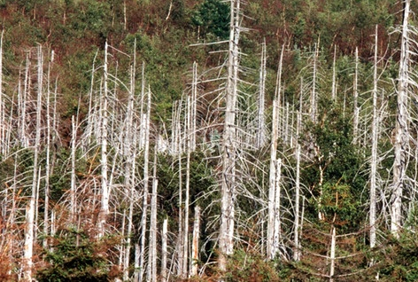

For a long time, environmental problems were mainly local problems that could be solved by national approaches.
But globalization puts global environmental problems into focus that require global cooperation.

Slide 3
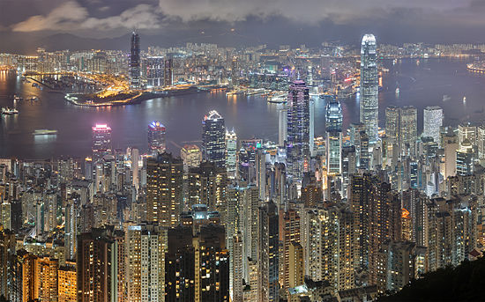
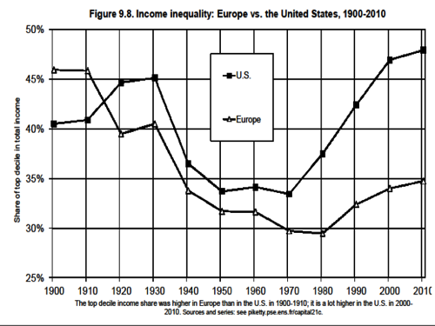
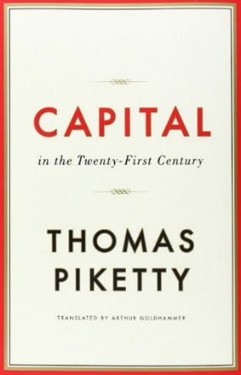
Globalization and economic growth have enabled prosperity.
But inequality is increasing.

Slide 4

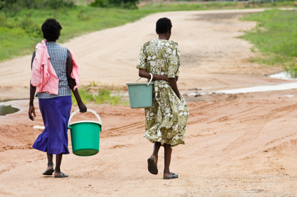
Innovation and technological change were for a long time the driving forces for relaxing physical scarcities.
But we experience an under-provision of public goods and social capital.

Slide 5
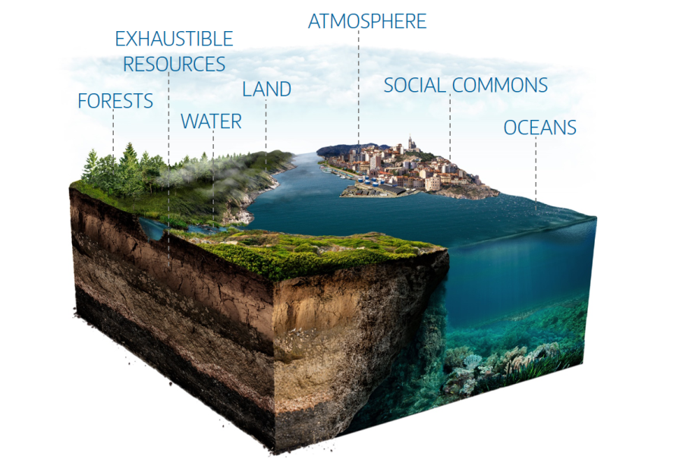
The challenge for the 21st Century: Management of the Global Commons
1) Avoiding the over-use of the natural commons
2) Overcoming the under-provision of public goods (social commons)

Slide 6
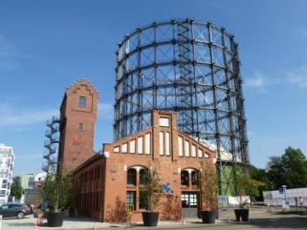
Mercator Research Institute on Global Commons and Climate Change (MCC)
MCC is a scientific think tank that was founded in 2012 by PIK and Stiftung Mercator. We are about 50 people, mainly with a background in social sciences, and Ottmar Edenhofer as Director.
We assess strategies for the sustainable management of the natural and social commons
The MCC aims to identify synergies and trade-offs between different policy objectives in the context of climate change and sustainable development
We analyze solution options to inform the public debate and policy making.

Slide 7
MCC’s Mission
MCC’s mission is to provide solution-oriented policy pathways for governing the global commons to enhance sustainable development and human well-being.
Our approach is based on high-quality research to inform policy making in an iterative societal learning process.
Our work is
Long-term and global
National and worldwide
Transdisciplinary and thematically broad
Independent and relevant

Slide 8
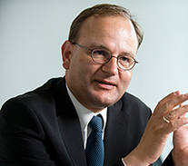
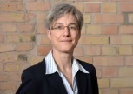
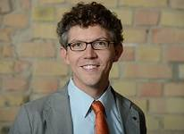
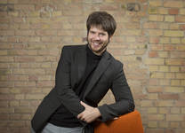
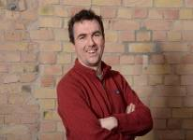
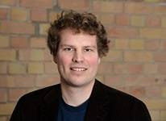
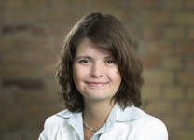
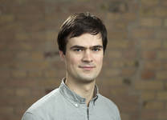
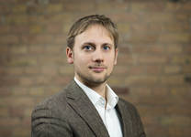
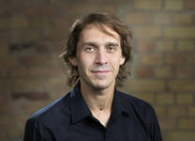
Working Groups at MCC
Director Secretary General
Prof. Dr. Ottmar Edenhofer Dr. Brigitte Knopf
Economic Growth and Human Development
Prof. Dr. Matthias Kalkuhl
Climate and Development
Dr. Jan Steckel
Applied Sustainability Science
Prof. Jan Christoph Minx, PhD
Land Use, Infrastructure and Transport
Prof. Dr. Felix Creutzig
Sustainable Resource Management and Global Change
Prof. Dr. Sabine Fuss
Governance
Prof. Dr. Christian Flachsland
Scientific Assessments, Ethics, and Public Policy
Dr. Martin Kowarsch
Task Force Public Economics
Dr. Michael Jakob

Slide 9

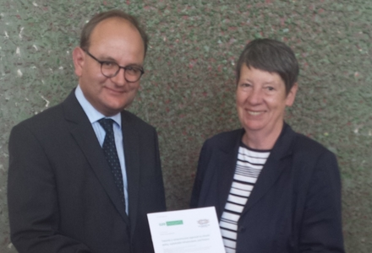

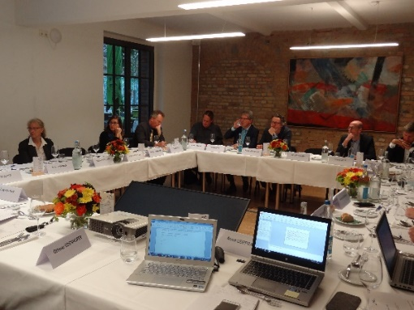
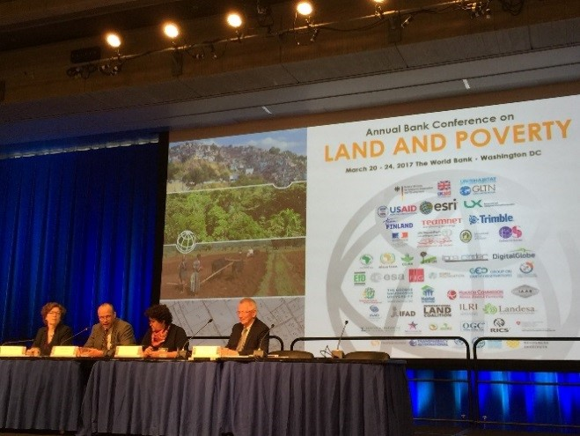
Highlights from the science-policy interface
G20 process 2017: joint initiative on carbon pricing in the G20 countries with Industry (BDI) and a NGO (Germanwatch)
Dialogue Forum organised by MCC on the reform of the EU Emission Trading Scheme
Comprehensive report on land taxes in developing countries coordinated by MCC, together with PBL; presented to World Bank and NL government

Slide 10
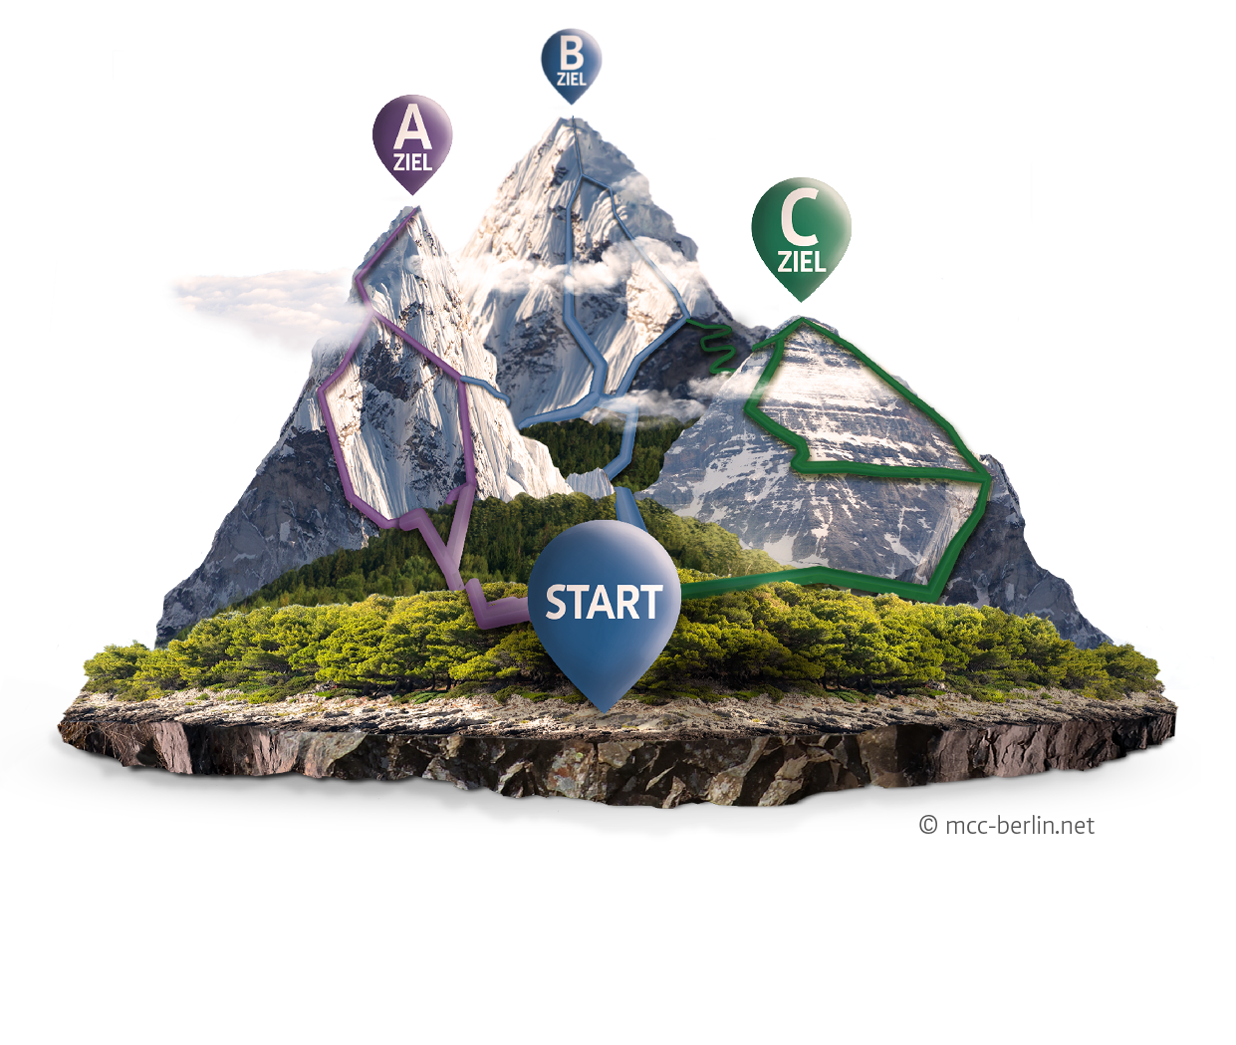
Providing maps of knowledge for scientific policy advice
Exploration of alternative pathways
Researchers as cartogrophers

Slide 11
Kontakt
Dr. Brigitte Knopf, Generalsekretärin
Mercator Research Institute on
Global Commons and Climate Change gGmbH
Torgauer Str. 12–15 | 10829 Berlin | Germany
tel +49 (0) 30 338 55 37 - 101
mail knopf@mcc-berlin.net
web www.mcc-berlin.net
twitter @BrigitteKnopf
MCC was founded jointly by Stiftung Mercator and
the Potsdam Institute for Climate Impact Research

